Slide 1
Catch the Opportunity
Overcoming Leasing and Renewal Objections
Facilitated by: Tracy Chambers, Derek Podgornik, Kellie Sleeper, and Valerie Whitlock

Slide 2
Mission Statement
Infusing energy, enthusiasm, and proven strategies into the art of handling objections, empowering property management professionals to turn obstacles into opportunities while fostering a vibrant and customer-focused leasing experience.

Slide 3
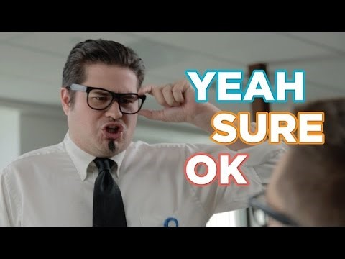
Listening By Interrupting

Slide 4
What’s an objection and what are the two general types we come across?
Objections – a reason or objection presented in opposition. In our case, a reason a prospect won’t rent or resident won’t renew.
Verbal – when the person tells you exactly why they won’t lease or renew.
Non-verbal – underlying objections that are not directly disclosed.
Objections are often just surface answers where we have to dig deeper and find the true objection so we can successfully close the lease/renewal!

Slide 5
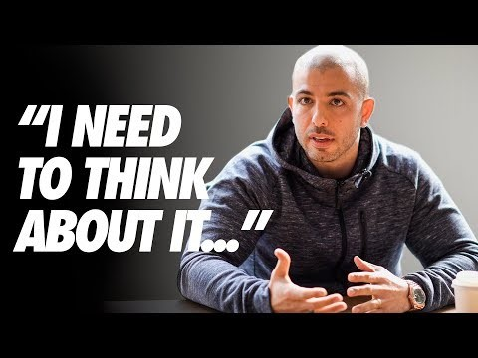
I Need To Think About It!

Slide 6
How do FISH! Principals apply to Overcoming Objections?
Choose Your Attitude
Maintain a positive and open mind.
Demonstrate confidence in your product and team.
If you hear “no,” figure out why, what we can do, and/or how we can learn from it.
Play
Keep a light-hearted approach.
Create a fun/engaging experience.
Make Their Day
Take care of their needs and find alternate options that solve their objections.
Maintain a positive atmosphere and express hospitality/show empathy appropriately.
Be Present
Active listening and truly understating their objection.
Avoid distractions and make them your primary focus.

Slide 7
GAME TIME!!!
Understanding and Overcoming Common Objections Game

Slide 8
Objection #1
Price is higher than comps / Too expensive / New communities at similar pricing / Raising rents without anything in return

Slide 9
Objection #2
My spouse/roommate needs to see it first.

Slide 10
Objection #3
I can buy a house at these prices!

Slide 11
Objection #4
I’m looking for a newer built community.

Slide 12
Objection #5
I have to/may sell my house and am unsure of move-in date.
OR
I’m in a lease now.

Slide 13
Objection #6
I prefer to have a bottom or top level apartment and you only have the other one available.

Slide 14
Objection #7
I prefer a 2-3 bedroom apartment and you’re short 1 bedroom for what we want.
OR
I prefer 1 bedroom and you only have 2+ bedrooms.

Slide 15
Objection #8
I prefer a 2-3 bedroom apartment (need more space) and you’re short 1 bedroom for what we want.
OR
I prefer 1 bedroom and you only have 2+ bedrooms.

Slide 16
Objection #9
I need to look at other places to compare.

Slide 17
Objection #10
I’m not sure I’ll qualify.

Slide 18
Objection #11
I would like a w/d in the apartment.

Slide 19
Objection #12
I need a pantry in my kitchen/need more storage space in general.

Slide 20
Objection #13
I really want a garage.

Slide 21
Objection #14
I may be looking at a different school zone or what I perceive a safer area.

Slide 22
Objection #15
Some of your reviews aren’t the best.

Slide 23
Closing With Confidence
What are some good “closing techniques” for when a prospect is just not ready to move forward with the application on-site?
"I really enjoyed showing you around today! Whether you decide to call this home or not, I truly appreciate your time, and I’m here if you ever have any questions."
"I know you’re still weighing your options, so I’ll check in next week to see if you have any questions. In the meantime, would you like me to send over some move-in tips or neighborhood recommendations?"
"Even if the timing isn’t right today, we’d love to welcome you in the future. If anything changes, just reach out, and I’ll be happy to help!"

Slide 24
Closing With Confidence
What’s one thing you can do to make a prospect/resident feel special, even if they don’t say “yes” right away?
Have you ever had someone come back later because of a great first experience? What made the difference?

Slide 25
What other objections do you experience at your own communities?

Slide 26
Summary
In summary, we’ll come across many different objections daily. We need to know that in order to resolve and overcome them, we need to truly understand what the actual objections are. By asking follow-up and exploratory questions and actively listening to what they’re saying instead of figuring out how we can respond, we can gather more information and figure out solutions for the prospect or resident. And when implementing FISH! Philosophies into your presentations, you’ll create that unique experience for prospects and residents where they’ll never forget you! We may not have covered each of the objections you experience at your own community on a regular basis today, but each of you should have a list of what you come across and different solutions in order to overcome them.
Happy Leasing and Renewals!

